Slide 1

Building a native app for Windows
Which UI framework should you choose?
Alvin Ashcraft
Notes:
Welcome to this month’s Boston .NET Architecture User Group.
My name is Alvin Ashcraft, and this month’s topic is about choosing the best UI framework for your next Windows application.
There are a slew of options out there, and we’ll be touching on many of them tonight, focusing primarily on the options from Microsoft.

Slide 2
Alvin Ashcraft – About Me
SOFTWARE DEVELOPER & ARCHITECT FOR 25+ YEARS​
.NET / C# / WPF / ANGULAR / SQL SERVER​
MORNING DEW LINK BLOG – WWW.ALVINASHCRAFT.Com
DAILY LINKS FOR DEVELOPERS SINCE 2007​
AUTHOR OF 3 BOOKS​ - Packt Publishing
LEARN WINUI 3 (1ST & 2ND EDITIONS)​
PARALLEL PROGRAMMING AND CONCURRENCY WITH C# 10 AND .NET 6​
JOINED MICROSOFT in March 2022​ - Sr. Content Developer
CONTENT TEAM > SKILLING ORG > COMMERCE & ECOSYSTEMS​
WINDOWS Developer Documentation (WIN32/UWP/WINDOWS APP SDK)​
TECHBASH Developer Conference
ORGANIZER Since TechBash 2016
TECHBASH FOUNDATION - Founding BOARD MEMBER
Notes:
A little background about me…
For those who don’t know me, I’ve been in the software industry since 1995, with most of that time (over 25) years spent as a developer and architect using various Microsoft technologies.
Some of you may also be familiar with my blog, the Morning Dew, where I’ve been posting daily links for .NET developers since 2007.
I also have three books from Packt Publishing. You can check those out on Packt’s website or on Amazon. Just search for my name.
Writing those books led me to pivot my career to technical writing. I joined Microsoft two years ago as a content developer. I write documentation, training modules, and code samples on Microsoft Learn. I work on the Windows developer docs team, helping to maintain the docs for client apps and APIs. I have another talk I give about my work as a content developer and how anyone can contribute to content on Learn through GitHub issues and PRs.
Finally, I’m one of the founding organizers of the TechBash developer conference. We’ve been running the event in the Poconos since 2016, and…

Slide 3



September 24-27, 2024 | Pocono Manor, PA
Amazing speakers with fresh content.
A fraction of the cost of the more crowded conferences.
- 3-day conference plus lodging for ~$1000
4th day of pre-conference workshops available.
Kalahari Resort Poconos – easy drive from major NE cities.
World-class keynote speakers.
In addition to the sessions, you get a great hallway track, amazing food, attendee Welcome Reception, Game Night & more!
Family Day Friday - full day of kids' sessions, free for attendees' families.
Discounted hotel rooms with free water park access: stay, learn & play all week!
Info: techbash.com or @techbash
Call for speakers: sessionize.com/techbash-2024/
Notes:
Our next event, TechBash 2024, is coming up in September.
It’s a conference at the Kalahari Resort in the Poconos with 3-day and 4-day options. We have an awesome time every year. It has the food, speakers, and content of a big event like VSLive or Microsoft Build with a size of a large code camp or other regional conference. You can bring your whole family for the water park, Thursday Game Night, and our Friday Family Day sessions for kids.
If you’re a speaker our 2024 call for speakers is currently open through March 8th. Speakers get a full conference pass and if your company doesn’t cover your travel, we’ll cover up to two nights in the hotel at the resort.

Slide 4
Agenda
A brief history of Windows development
Today’s Choices – Pros & Cons
Windows Forms
WPF
UWP
WinUI 3 & Windows App SDK
.NET MAUI
Uno Platform, Blazor & Avalonia
Guidelines when choosing a framework
Resources and Q&A
Notes:
Let’s get to tonight’s agenda.
We’ll start with a brief review of the history of Windows development since the introduction of .NET.
Then we’ll review some reason why you may or may not decide to choose each of these UI frameworks, followed by a look at some code for each of them.
I created a sample app using each framework. It’s a very basic shopping list app that loads some sample data. Each app shares the same code to load the sample data, and you can add more items, mark them as purchased or remove them from your list. We’ll see the similarities and difference and you’ll see that I’m not the best at UI design, no matter which framework I use.
We’ll finish up with some guidelines you can use when selecting a framework for your next Windows project.
And we’ll review some online resources you can keep handy, and hopefully we’ll have some time for Q&A. But feel free to ask questions as we go. It’s usually best to address any questions while they’re in context, and there’s a good chance that you’re not the only one with that questions. If I don’t see questions in chat, please interrupt me any time.

Slide 5
.NET Desktop Development History
2002 - Windows Forms (WinForms)
Successor to VB 6 forms
Bill Gates demo of Visual Basic form designer in 1991: https://youtu.be/Fh_UDQnboRw?si=vO9IUCn05qW_w8PO
2006 – Windows Presentation Foundation (WPF)
2015 - Universal Windows Platform (UWP)
Successor to Windows 8.x apps - 2012
2021 - WinUI and Windows App SDK (March)
2021 – Blazor Hybrid (November)
2022 - .NET MAUI (Multi-platform App UI)
3rd Party Cross-Platform Options
Uno Platform (UWP/WinUI XAML)
Avalonia UI (WPF XAML)
Notes:
This is the simplified timeline of UI frameworks for .NET developers since .NET’s introduction in 2002.
WinForms has been there for every step of the way. Even before WinForms in .NET Microsoft has had a forms designer for Windows apps since 1991 when Bill Gates demoed the VB form designer.
Windows Presentation Foundation (or WPF) was introduced around the same time as Windows Vista in 2006 and was the first XAML-based UI framework from Microsoft, followed by everyone’s favorite web development framework, Silverlight, in 2007. WPF became a big deal for enterprise developers, and quickly overtook WinForms as the de-facto choice for businesses building Windows apps.
We’ll skim over the Windows 8 XAML apps that debuted in 2012 and talk about UWP apps. They were introduced in 2015 with Windows 10, and UWP apps gave developers a way to target Windows on desktops, phones, HoloLens, and Xbox with a single project. They had some success with ISVs building consumer apps, but never found a place in the enterprise. The constraints of the other platforms, held back the Windows 10 desktop capabilities. We’ll talk more about those things later.
2021 gave use two new options for Windows apps, WinUI 3 (and the Windows App SDK) and Blazor Hybrid apps. WinUI 3 was launched as a successor to UWP, and Blazor Hybrid apps give web developers a way to build for desktop and mobile clients.
We’ll also talk about some new options that allow you to target Windows and beyond. .NET MAUI is the successor to Xamarin.Forms, and it allows you to use XAML and C# to build apps for Windows, macOS, iOS, Android and Samsung watches & smart TVs. There are some 3rd party options that we’ll touch on as time permits. Uno Platform and Avalonia UI both target the same platforms as MAUI in addition to Linux and web support (with WebAssembly).
If we had more time, we could also talk about Flutter, React Native for Windows, JavaFX, Electron, and many other options for building apps for Windows and beyond.

Slide 6
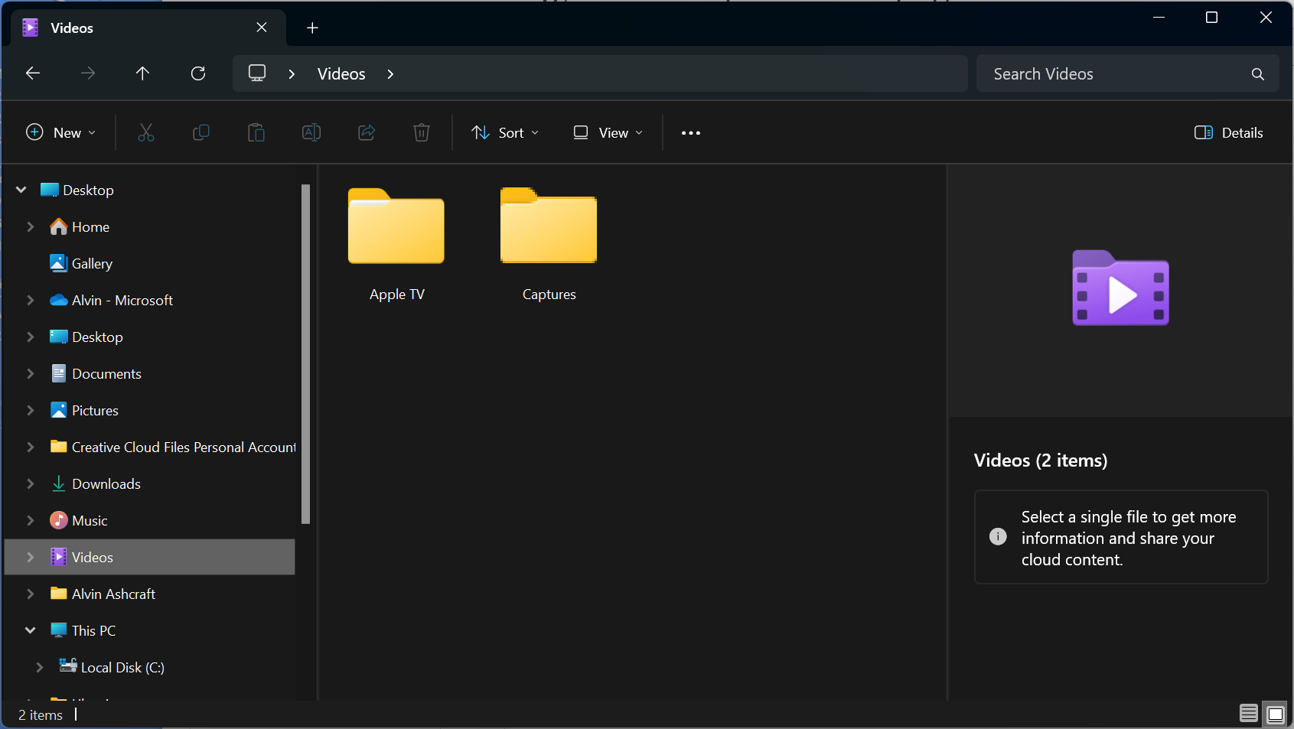
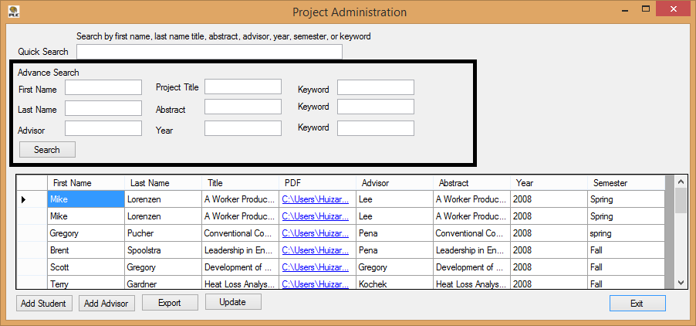
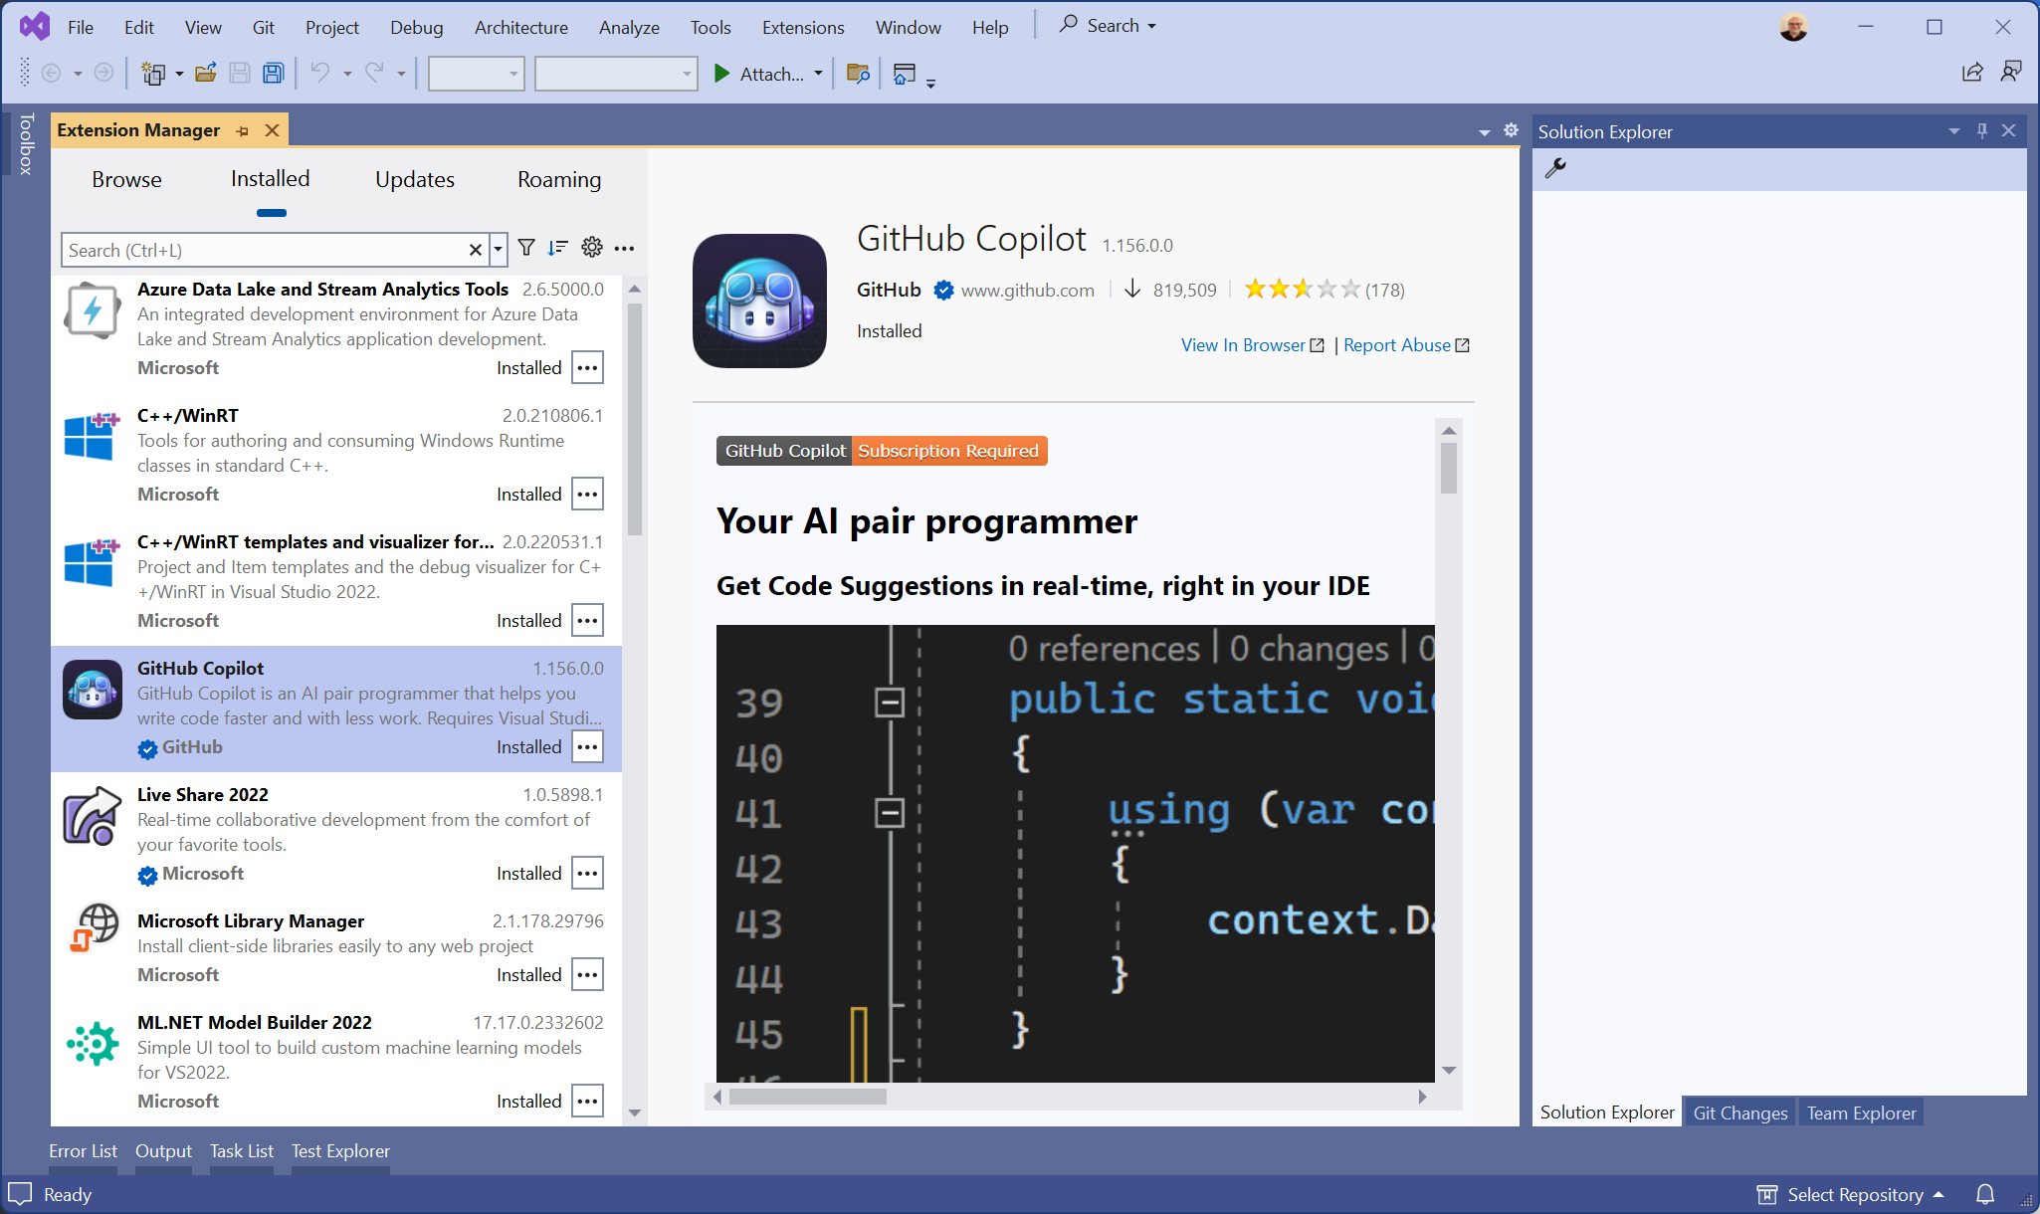
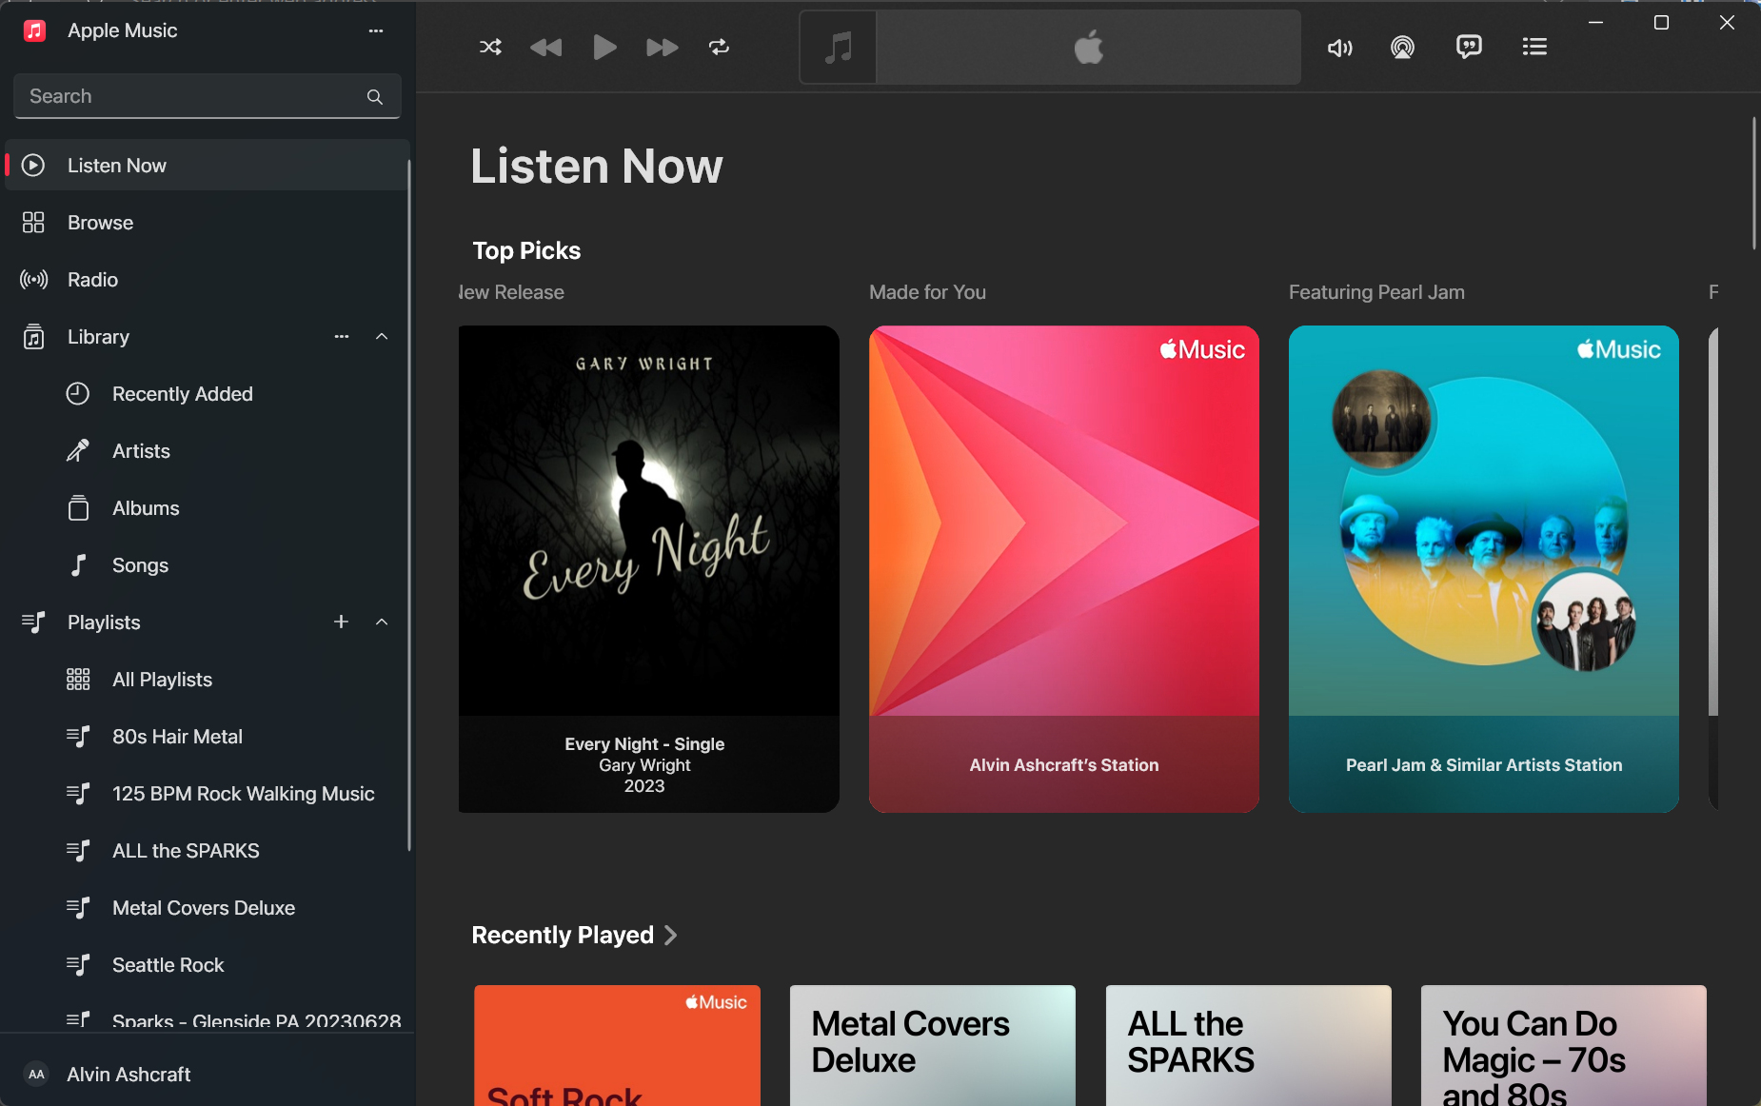
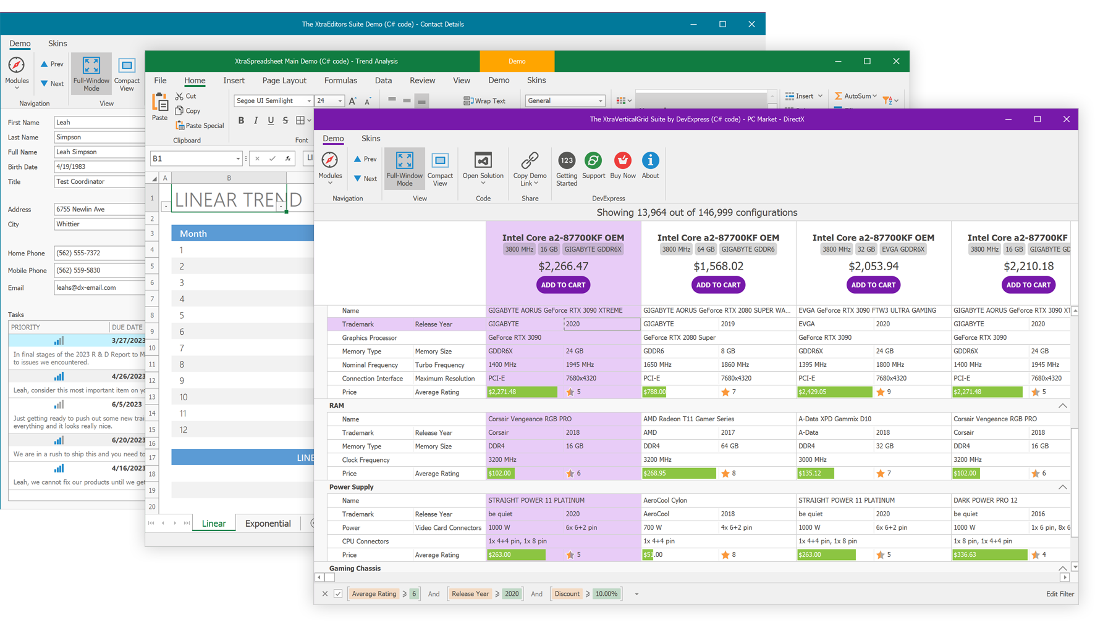
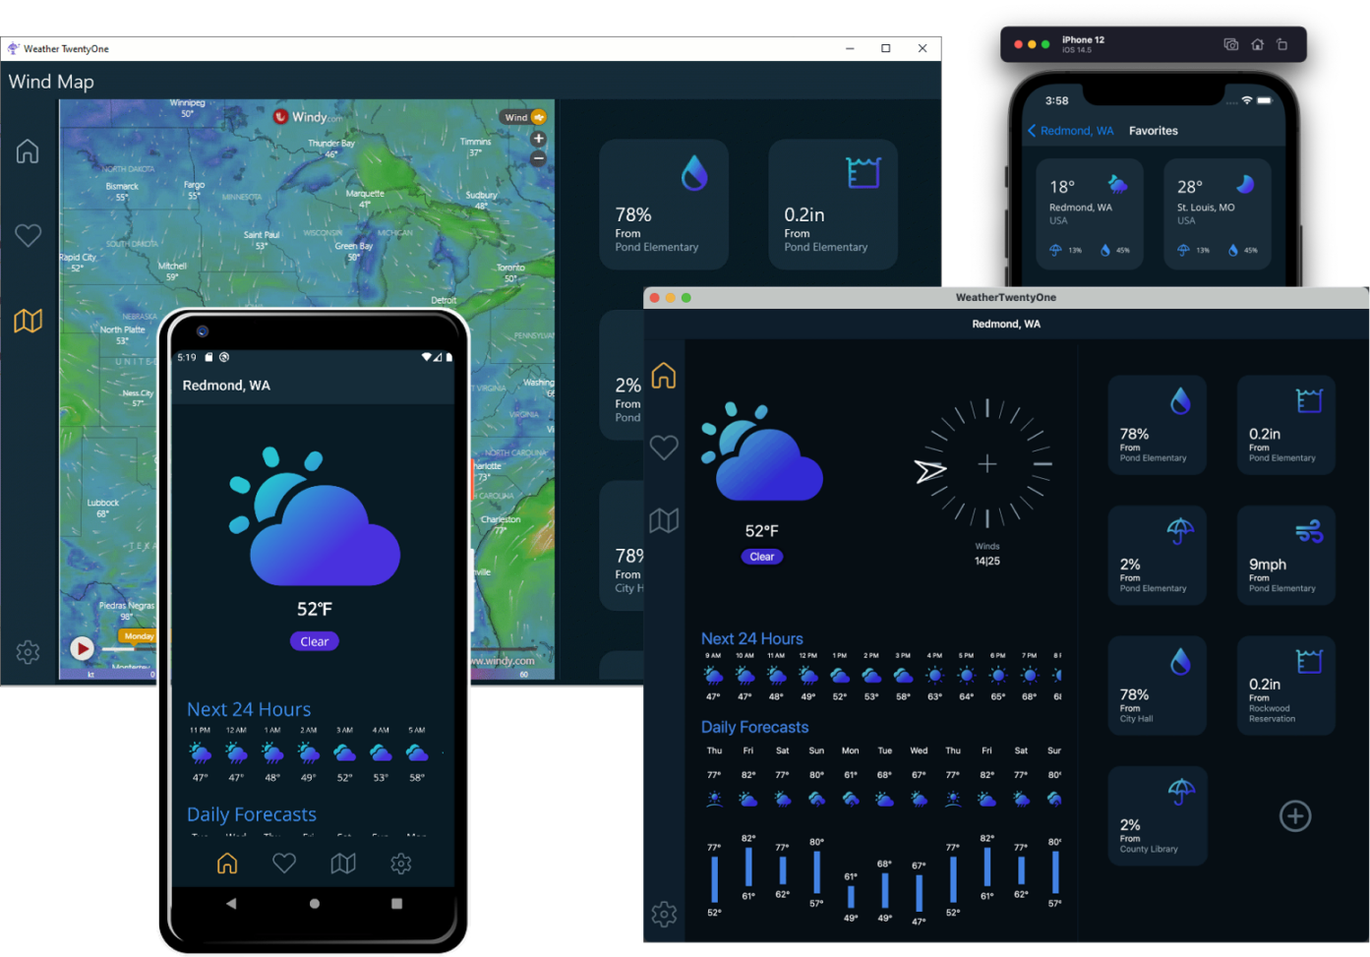
User Interface Examples
Notes:
Here are a few examples of Windows user interfaces created with different UI Frameworks.
The two on the left are both WinForms.
The upper-left screenshot is probably the type of UI you picture when you hear Windows Forms. It looks very Windows XP… utilitarian. I’ve probably created Uis similar to this in VB 6 back in the day.
The lower left is a WinForms UI with some third-party controls and theming applied. This particular example was taken from DevExpress. With the help of third parties, there’s a lot you can create with modern .NET’s Windows Forms.
The screen in the middle probably looks familiar. That’s Visual Studio 2022 with the preview UI for their Extension Manager open. Nearly all of the Visual Studio UI is WPF. There are a few remaining legacy dialogs left (like the Options dialog), but it’s mostly WPF.
The lower-center screens are created with .NET MAUI. Microsoft created a weather app that is responsive to different desktop and mobile form factors. You can get the source code for this app on GitHub. Just search for .NET MAUI weather sample app.
The top right image is a screenshot of my Windows File Explorer in Windows 11. The new builds of Windows 11 have a File Explorer that is built with WinUI. Microsoft and some key partners like Apple and Adobe have been using WinUI 3 to create some desktop apps in the last year or so. The Apple Music app is the last image here. You can download that, as well as Apple TV and Apple Devices apps from the Microsoft Store. All three were built with WinUI 3 and the Windows App SDK. Adobe’s WinUI app is Fresco, if you want to check that out.

Slide 7

Windows Forms Advantages
Rapid UI development with forms designer and data binding
Third-party control support
Modern and legacy options
.NET Framework to target legacy Windows
.NET 8 for modern language features and performance
Upgrade .NET Framework apps to modern .NET with Visual Studio
Active* Development (Accessibility, High DPI, Performance, Dark Mode?)
Roadmap: https://github.com/dotnet/winforms/blob/main/docs/roadmap.md
Every C# (or VB) developer is already a WinForms developer
Notes:
Let’s get into the details, starting with WinForms…
Developers love WinForms because it lets you build simple apps fast. It has a visual drag & drop designer to build your UI, and everything is C# (or VB) code.
Like we saw on the last slide, there has been strong 3rd party support for WinForms controls and other components for years.
There are two options for creating a new WinForms project. Most of you will want to select the modern .NET option ( that’s .NET 8 today), but you still do have the options to create a new WinForms project on .NET Framework 4.8. If you have clients running unsupported Windows 7 machines, you can still build and maintain .NET client apps for them.
If you have existing .NET Framework WinForms apps, Microsoft has a .NET Upgrade tool you can use to move them to .NET 8. This tool can also upgrade legacy WPF apps to .NET 8 WPF, Xamarin.Forms apps to .NET MAUI, or UWP apps to WinUI 3.
Windows Forms is still supported and under active development. You can visit this page on GitHub to review their public roadmap and see upcoming features.
There’s no XAML, CSS, or any other UI language to learn. Every .NET developer can be a WinForms developers.

Slide 8

Windows Forms Drawbacks & Demo
It looks like Windows Forms – Dated UI
No support for Windows Fluent Design
Looks like Windows XP
No GPU acceleration
No C++ support
No current support for Windows themes (Dark Mode)
3rd Party Theming Options
Not great for Touch and Pen input
Notes:
Let’s briefly touch on a few reasons why you may decide not to choose Windows Forms, and then we’ll look at the code.
Without any custom theming applied, it looks dated. It’s had some updates to improve the UI a bit since Windows XP, but you won’t be implementing Microsoft Fluent Design or Google’s Material Design in a WinForms app any time soon.
The XAML-based languages can take advantage of rendering on modern GPUs, improving the performance of complex UIs.
There’s no C++ language support for WinForms projects (or F# for that matter). It’s C# and VB only.
There’s no built-in support for switching between light & dark themes when users update their Windows theme. We saw that there are some 3rd party theming options for with light and dark themes though.
It’s also not great for touch input or ink support with pen input on touch devices.
OK, let’s look at some code!

Slide 9
WPF Advantages
Extensible Application Markup Language (XAML) designer
XAML Hot Reload for UI debugging
GPU Accelerated UI – DirectX pipeline
Rich data binding with MVVM pattern
Modern and legacy support (.NET Framework and modern .NET)
3rd Party control and library support (Theming)
Active development
Roadmap: https://github.com/dotnet/wpf/blob/main/roadmap.md
Windows 11 theming support
Positioned as top choice to build native Enterprise apps for Windows
Notes:
Next up is WPF…
WPF apps have a XAML-based UI. If you’re not familiar with XAML, it’s a schema-bound XML markup language with support for data binding, styles, and loading static and dynamic resources.
Visual Studio provides a UI designer for WPF, as well as XAML Hot Reload for making simple changes while debugging without having to stop and start your debugging session. It also has tool to debug data binding errors and for analyzing the WPF visual tree – that’s the hierarchy of controls/elements in the UI.
As previously mentioned, XAML-based UIs are GPU accelerated, being rendered on in the DirectX pipeline.
Data binding in WPF is extremely powerful and lends itself to using the Model-View-ViewModel (or MVVM) pattern. If you catch my session here next month, we’ll spend some time talking about the advantages of MVVM with WinUI.
Like WinForms, WPF has .NET and .NET Framework project options and extensive 3rd party product support. It’s under active development, and if you check out the roadmap on GitHub, you’ll see that they’re working on built-in theming support for Windows 11.
WPF is still the framework of choice for many companies building line-of-business apps for Windows, and Microsoft continues to position it as such.

Slide 10

WPF Drawbacks & Demo
XAML learning curve
No C++ support
No dark mode switching (yet)
No current support for Fluent Design
Default UI still looks like Windows Vista
Better for Touch and Pen input but not best in class
UI Performance Not as optimized as UWP/WinUI
Notes:
The primary downside for many developers is the XAML learning curve. I love working with XAML, but it’s not everyone’s favorite UI language.
Like WinForms, it’s C# and VB only.
The Windows theming and dark mode switching is still on the way. The current UI doesn’t look like Windows 10/11 out of the box yet. It still looks kind of like Vista, but that refresh is on the way. We’ll see how Fluent it looks when they’re done.
It’s better for touch and pen than WinForms, but it wasn’t built for today’s devices like UWP and WinUI.
Performance-wise, it’s better when you use .NET 8, but there are some improvements in the rendering pipeline that make UWP and WinUI user interfaces smoother.
Let’s look at the WPF project next.

Slide 11

UWP Advantages
.NET Native optimization
Built to perform on Windows, Xbox and Windows Phone with limited resources
Xbox Support (and HoloLens ☹)
XAML Designer
Great for Touch and Pen input
Windows Theme support (dark mode)
Rich data binding support with MVVM
WinUI 2.x controls and libraries (Some Fluent Design support)
Security with Windows Sandboxing (AppContainer)
Notes:
Let’s talk UWP apps now…
Thanks to Windows Phone, UWP apps are optimized for performance. They are small and memory-optimized with the .NET Native runtime. The latest WhatsApp app for Windows in the Microsoft Store was built on UWP, and it’s got great performance.
It technically supports HoloLens and Xbox, but HoloLens is officially deprecated, and I haven’t heard folks pushing UWP developers to build Xbox apps in a long time.
Visual Studio has a XAML designer for drag & drop UI building, although I prefer to code my own in the XAML markup. The designer tends to make UIs that are less responsive to resizing.
These apps were built for pen and touch and provide dark mode support.
Like all XAML languages, you have data binding and MVVM.
The WinUI 2 libraries provide some additional controls with some Fluent design support, and additional helpers & styles.
UWP apps are sandboxed, which means they have limited access to the file system and other Windows resources. This provides users some additional security from bad actors.

Slide 12

UWP Drawbacks & Demo
No more feature updates
Bug fixes and security updates only
No new features for WinUI 2.x either
.NET Native means no modern .NET features or optimizations
No C# 8 or later features
No Fluent UI updates (Windows 10 UX)
Unknown Support Lifetime
.NET Standard libraries – Uncertainty
Tied to Windows SDK versions
Notes:
The downside of building UWP apps.
Well, unless you have a great reason, I don’t recommend building a new UWP app today.
While it’s still going to be supported by Microsoft for the foreseeable future, it’s getting no new features. That includes WinUI 2 controls. They’re both only getting critical security updates and bug fixes.
While .NET Native is small and fast, it’s also aging. With UWP, you get no access to modern .NET or language features. In fact, you can’t use any C# language features beyond C# 8 (and we’re up to C# 12 now in .NET 8 – it’s always the .NET version plus 4).
While WinUI 2 has some Fluent design look & feel, it’s Fluent 1.0 (Windows 10). The Windows 11 look is Fluent 2.0. You can’t get that in UWP without some work on your part to style it.
UWP relies on .NET Standard for shared libraries (NuGet packages), and Microsoft is moving away from that standard to just using .NET as the standard feature set across platforms. That leaves UWP behind.
Finally, UWP versions are tied to Windows SDK versions. We’ll see how WinUI separated itself from this dependency on Windows.
Let’s take a very quick look at the UWP Shopping List app.

Slide 13
WinUI 3 & Windows App SDK Advantages
Windows 11 Fluent Design UX
Features and controls of UWP without coupling to Windows SDK
Frequent Windows App SDK updates
1.2 - 1.4 – XAML Islands, Theming, Notifications, AppWindow & MediaPlatyerElement
V 1.5 (Preview) – Maps control and layout improvements
Roadmap: https://github.com/microsoft/WindowsAppSDK/blob/main/docs/roadmap.md
Rich data binding with MVVM
Great for Touch and Pen input
Upgrade from UWP with the .NET Upgrade Assistant
Positioned as top choice for ISVs to build native Windows apps
Windows File Explorer, Apple Music & Adobe Fresco
Notes:
Now we’re talking WinUI…
WinUI 3 is the UI component of the Windows App SDK.
It supports the latest Fluent design concepts, so you get the most modern looking apps with the least amount of effort/coding.
You get the features and controls of UWP without being coupled to a specific version of the Windows SDK. The Windows App SDK updates multiple times a year. Some of the recent updates brought XAML Islands, Theming, Notifications, improved windowing with AppWindow, and media controls. Version 1.5 will bring the much anticipated Maps control. It’s one of the top requested features. We’ll get to the other requests on the next slide.
You can check out the roadmap on GitHub.
Like UWP, it’s great for data binding with MVVM, touch & pen input.
You can upgrade apps from UWP with the .NET Upgrade Assistant.
You can also get even more free controls for WinUI with the Windows Community Toolkit and .NET Community Toolkit. I’ll talk about those next month or you can read about them in my WinUI 3 book.
Finally, Microsoft is really positioning WinUI 3 as the top choice for ISVs to build apps for Windows. You can see that commitment in their partnerships with Apple & Adobe to bring high profile, first-class apps to Windows.

Slide 14
WinUI Drawbacks & Demo
No XAML UI Designer in Visual Studio
One of the top requested features
XAML learning curve
Use XAML Hot Reload for UI debugging
No F# or Visual Basic support (If you’re a VB diehard)
C# and C++ only
No Xbox or HoloLens support (for UWP upgrades)
No Built-in Data Validation for UI Controls (Yet?)
Another top requested feature on GitHub
There are work-arounds (See my WinUI 3 book)
Notes:
Let’s discuss a few drawbacks with WinUI 3.
The big barrier for entry for new XAML developers is the lack of a UI designer in Visual Studio. This has been the top request since WinUI’s release three years ago. The product teams are aware that it’s wanted. To this point, it hasn’t made it onto the public roadmap.
I think they could satisfy many people by releasing a read-only UI preview for design-time. If you could see what you’re building in the XAML without starting a debugging session, it would be a huge quality-of-life improvement for WinUI developers. Right now, we have to debug the app and rely on XAML Hot Reload to experiment with UI changes.
Next, WinUI apps only support C# and C++. There’s no support for VB or F#.
If you’re porting a UWP app to WinUI, you’ll have to leave the Xbox and HoloLens support behind. WinUI is Windows desktop only.
Finally, another highly requested feature on the team’s GitHub repo is data validation for WinUI controls. This one could make it into the framework eventually, as there was an implementation started while WinUI 3’s first release was still in preview. If you pick up a copy of my WinUI book, I add data validation to an app with a workaround that’s easy to add to your own apps.
Now let’s look at the WinUI app. This one has a basic MVVM implementation.

Slide 15
.NET MAUI Advantages
Cross-Platform (Windows, Android, iOS, macOS, Tizen)
No Linux support (see Uno Platform & Avalonia)
Xplat with Platform-Specific Implementations
Libraries abstract some platform features
Change Appearance by Platform (OnPlatform Markup Extension)
Easy to Learn for XAML developers
Xamarin Migration available
MVVM Pattern with Rich Data Binding
Create UI in C# with .NET MAUI Community Toolkit & C# Markup
MVU Pattern (Model-View-Update) – Similar to Flutter development
Uses WinUI 3 for Windows
Web developers can use Blazor Hybrid to build for mobile
Notes:
If you want to build an app for Windows, and you’re also thinking about targeting other platforms, you have several options. Microsoft’s cross-platform option is .NET MAUI, the successor to Xamarin.Forms.
MAUI apps can be deployed to Windows, Android, iOS, macOS, and Samsung Tizen devices (watches and TVs). Linux is often requested, but it’s not yet supported.
With MAUI, you can create a single codebase to target all platforms.
- You can create platform-specific code to access native functionality.
- MAUI also has helpers to wrap many common device functions (file system, camera, etc).
- To create platform-specific UI in your XAML, there’s an OnPlatform markup extension to light up parts of the UI.
If you’ve built other XAML apps, picking up .NET MAUI is pretty simple. It supports MVVM for separate of concerns and data binding.
However, you can also create your MAUI UI entirely in C# with the .NET Community Toolkit and C# Markup. When doing this, you can use the MVU pattern, which is similar to how Google’s Flutter apps are typically built.
When MAUI apps are compiled and deployed to Windows, they’re WinUI under the covers.
There’s also a Blazor Hybrid app template for .NET MAUI. This allows you to build your UI in Razor components which get hosted inside a custom WebView control in the MAUI host. We’ll also touch on Blazor Hybrid apps for desktop in a bit. You can take the same approach on desktop with WPF or WinForms WebView hosts.

Slide 16
.NET MAUI Drawbacks & Demo
Platform-Specific code required for accessing some native OS features
No XAML Designer in Visual Studio (Use Hot Reload)
Only C# - No C++, F# or Visual Basic
F# via Blazor Hybrid
Windows support is there but iOS/Android are top priorities
Use WinUI if Windows is your primary target
Some limitations on UI customization
Not all controls (Button) have Control Templates to customize
Performance – Slower than native apps
Notes:
MAUI drawbacks…
The more platform-specific code your apps needs, the more complex it’s going to get. If you’re relying on device hardware access extensively, be prepared to have some per-platform implementations.
Like WinUI, there’s no XAML designer to build your UI.
MAUI is C# only right now. No official support exists for VB, F# or C++. You can use F# in a Blazor Hybrid app for MAUI (in your razor components).
More people are using MAUI for iOS & Android than they are for Windows. The team’s top priority now is getting developers ported from Xamarin to MAUI, as support for Xamarin ends this spring. So, Windows features in the backlog are probably not high on the list.
If you’re a more advanced XAML developer and use control templates to heavily customize your UI, not all MAUI controls support templating yet (like the Button control).
While .NET 8 is fast, any kind of abstraction like MAUI or Flutter is going to be less performant than building native apps.
Let’s look at the .NET MAUI shopping list app for Windows.

Slide 17
Uno Platform Advantages (or Avalonia)
Cross-Platform (Windows, Android, iOS, macOS, Web, Linux, Tizen)
Ability to write platform-specific implementations
Windows platform apps
Use Skia.WPF to run on Windows 7 and later
Use WinUI & Windows App SDK to run on Windows 10 (v19041) and later
WinUI Uno apps nearly identical to native WinUI apps
Copy/Paste simple projects and run Xplat
Supports C# Markup and MVU OR XAML and MVVM
Figma Plugin – Design in Figma and paste into your project
Themes support Fluent, Material and Cupertino design
Develop in Visual Studio, VS Code, or JetBrains Rider
Note:
Avalonia UI is a similar solution but with WPF XAML syntax.
Notes:
Advantages of using a 3rd party cross-platform solution like Uno Platform or Avalonia UI.
You get all the MAUI platforms plus Linux!
With Uno, you can use Skia.WPF to run on older platforms like Windows 7. If you’re only targeting Windows 10 or later, you’ll want to choose the WinUI option.
WinUI Uno project code is nearly identical to WinUI code. I created an Uno app for my book by creating an Uno Platform project with their new project wizard and copy/pasting my WinUI project code (XAML and C#). It just works for most basic apps. Like other cross-platform code, it gets more complicated with device-specific functionality.
You can use C# Markup or XAML to build your UI. The new project wizard will ask you which you want to use.
They have a Figma plugin so your design team can design your app screens and generate your Uno pages.
Uno can create apps with Fluent, Material or Cupertino look and feel.
Uno has plugins for Visual Studio, VS Code or JetBrains Rider. So, you can choose your preferred editor.

Slide 18
Uno Platform Drawbacks & Demo
No official support for VB or F#
Third-Party solution
Pay for Advanced Support from Engineering
No XAML designer (use Hot Reload)
Some platform-specific code required for native features
Not as performant as native apps
Notes:
Some of the drawbacks of platforms like Uno…
No official support for VB, F# or C++.
It’s a 3rd party solution. Some companies that use Microsoft solutions can be hesitant to work with 3rd party platforms.
There are paid options for advanced support. Avalonia also has licensing terms for app deployment.
Again there’s no XAML designer.
The platform-specific code issue we’ve discussed with MAUI.
And the cross-platform vs native performance concerns we discussed with MAUI.
Let’s take a quick look at the Uno version of our WinUI shopping list app.

Slide 19
Blazor Hybrid – Desktop & Mobile Apps for .NET Web Developers
Pros
No XAML learning curve for web developers
Powerful CSS styling
.NET compatibility
Use WPF or WinForms to integrate with existing desktop apps
Use .NET MAUI host for mobile apps
Cons
Interop has costs
Performance
Bugs?
Accessibility
Support across two products
Feels like Web, not native
Quick demo
Notes:
Blazor Hybrid on Windows (or mobile)
Pros
- No XAML learning curve. If you know Razor pages and C#, you’re ready to go!
- Again, web developers will love working with CSS instead of XAML styles.
- You’re building web and using .NET.
- You can build your hybrid app inside WPF or WinForms, which makes it easy to integrate with your existing apps on those platforms.
Cons
- Interop has its costs…. Performance, maybe bugs in the interop layer?, issues with accessibility, keyboarding, you’re dealing with support across desktop and web products.
- It feels like a web app… it’s got that bouncy feeling when you drag things around.
Let’s take a very quick lap around a Blazor Hybrid app…

Slide 20
Choosing a Framework
Programming Language
UI Framework
Drag & Drop Designer
UI Design Language
.NET Support
Legacy Windows Support
Touch Support
Cross Platform Options
Long Term Support Options
Current Features and Public Roadmap
Notes:
Some things to consider when deciding what to choose for a new Windows app…
What programming language does your team use?
Does your team have experience with existing UI frameworks?
Do they know XAML? Do they like it?
Do you need a UI designer in Visual Studio?
Do you need Fluent Design (or another design system)?
Do you want to work with .NET – maybe flutter or electron works better for your developers.
Do you need to support older Windows versions?
How about touch and pen support? How important is that experience?
Do you need xplat? Or do you think you will in the future?
Are you porting an existing solution?
How long do you expect to support your app?
Do the current features of each platform meet your needs? Are missing features even on the roadmap?

Slide 21

Resources
Windows App Development – Options & Features: https://learn.microsoft.com/windows/apps/get-started/dev-options
Overview of Windows Development Options: https://learn.microsoft.com/windows/apps/get-started/
Uno Platform Documentation: https://platform.uno/docs/articles/intro.html
Avalonia Docs: https://docs.avaloniaui.net/
Build a WPF Blazor Hybrid App: https://learn.microsoft.com/aspnet/core/blazor/hybrid/tutorials/wpf
My Books on Amazon: https://www.amazon.com/stores/author/B08WLD35BX
About Me with Social Links: https://about.me/alvinashcraft
Notes:
Here are some resources you can use to help your team decide which platform to choose for your next project.
You can get this slide deck on my GitHub “speaking” repo, along with a larger list of links and the two Visual Studio solutions I used tonight.

Slide 22
Questions?
Thank you!
Contact: alvin@alvinashcraft.com
Notes:
That’s it! Any other questions or thoughts?

